Slide 1
BELL RINGER
“An unjust law is no law at all.”
What do you think that this quote might mean?

Slide 2
DEBATE vs. DIALOGUE
Both debates and dialogues are ways of communicating and sharing information and ideas, with the intent to learn and to potentially change the minds of others.
But their format is very different…

Slide 3
DEBATE vs. DIALOGUE
DEBATE
Debate is oppositional
One searches for weaknesses in other positions
Assumes a single correct answer
There is a winner or loser
DIALOGUE
Dialogue is collaborative
One searches for strengths in all positions
People have different pieces of the puzzle.
No winner or loser

Slide 4
DEBATE FORMAT
Round 1
1st Affirmative
1st Negative
Round 2
2nd Affirmative
2nd Negative
Closing
Negative Rebuttal
Affirmative Rebuttal

Slide 5
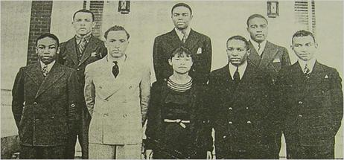
THE GREAT DEBATERS (2007)
The film is based on a true story and real people.
It depicts the Wiley College (Texas) Debate Team in the 1930s.

Slide 6
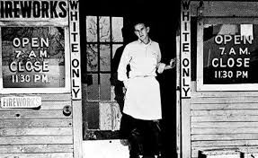
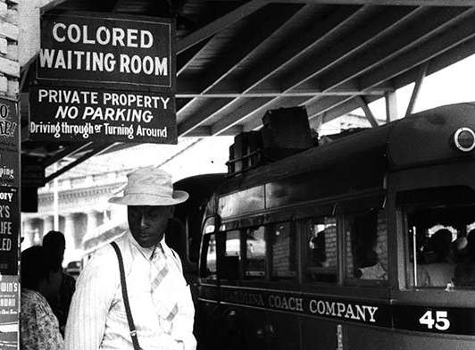
SEGREGATION (1870s-1960s)

Slide 7
SEGREGATION (1870s-1960s)
Segregation: Separating people based on their race or skin color.
Jim Crow: Laws that enforced racial segregation in the South.
Lynching: To be executed (usually by hanging) by a mob, without a formal legal process.
Civil Disobedience: A nonviolent refusal to obey unjust laws in an attempt to change them.

Slide 8
AS YOU WATCH THE FILM…
Pay special attention to (and take notes on):
The steps in the debate process
The lessons learned by the debate team and Mr. Tolson
Instances of injustice

Slide 9
Memes Assignment
To reflect on what we’ve learned about debate vs. dialogue, let’s create memes!
Go to www.imgflip.com/memegenerator (or another meme site). Use at least one key word, idea, or concept in your meme.
Upload them to the “Memes” channel found on our team page. Make sure to write one sentence for your meme explaining your choice of meme and how it relates to our topic.

